Slide 1
Topic 01 The Organisational Context of Information
ICT292 Information Systems
Management

Slide 2
Topic Learning Outcomes
At the completion of this topic, you will be able to:
Discuss the role of information in organisations, and explain how it can be categorised by source, subject and type
Explain how a generic business model can be used to understand the context of information in an organisation

Slide 3
Unit Learning Outcomes
This topic contributes to the following Unit Learning Outcomes:
LO1: Demonstrate an understanding of the role of information in organisations, and how it is managed.

Slide 4
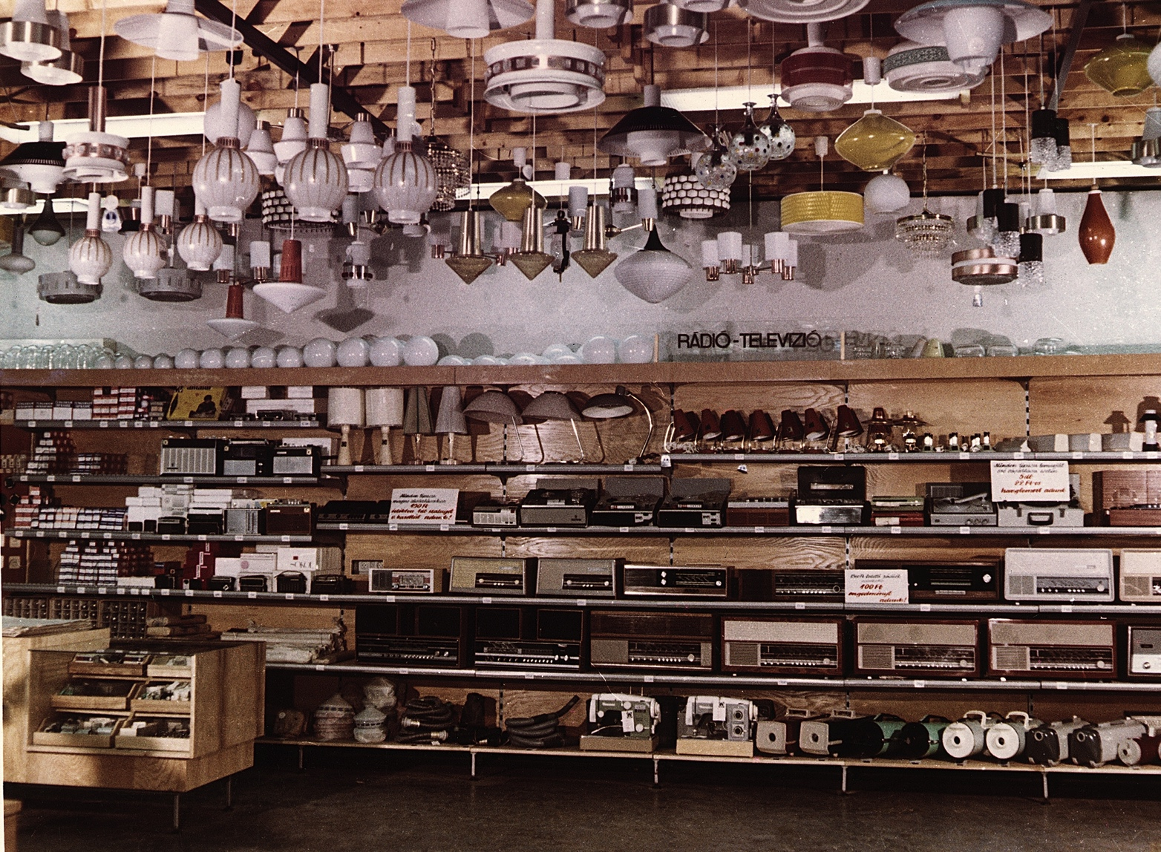
Resources for the Topic
Text Chapter 1
In particular, you should make sure that you have read the sections relevant to the Bright Spark case study
FOTO:FORTEPAN / Erky-Nagy Tibor

Slide 5
Topic Outline
Organisational Need for Information
Business Models
Organisational Architecture
Summary

Slide 6
Organisational Need for Information

Slide 7
What is an Organisation?
One definition:
“An organization is a social entity within which a series of processes take place in order to achieve a specific purpose” (Senior & Swailes, 2010)
There are many others, but they tend to have some common features
Working to achieve a specific outcome
Made up of people
Structured in some way

Slide 8
What is information?
Information is the output of some action in which the organization has been involved
A record of a transaction (e.g., a sale)
An email
A transcript of a telephone conversation with the Helpdesk
Information may be categorised by:
Source: internal or external; formal or informal
Subject: internal or external
Type: quantitative or qualitative

Slide 9
Information Collected | Type of Information | Subject of Information | Source of Information
Selling price of lampshades to customers | Quantitative | Internal | Internal
The extent to which the lampshade complements or completes the product range offered to customers | Qualitative | Internal | Internal
Number of competitors stocking the same product | Quantitative | External | Internal
Need information about the anticipated demand for the product based on sales trends | Both | External | Internal
Purchase price of lampshade from manufacturer | Quantitative | External | External
Need information about expected new products to be launched | Qualitative | External | External
Business Information Cube in Bright Spark (adapted from Cox, p.14)

Slide 10
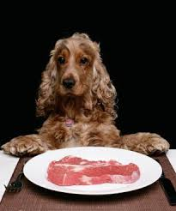
Information in Organisations
Information is needed to:
Record business transactions
Trigger business processes
Provide the basis for organisational decisions
http://www.dog-obedience-training-review.com/homemade-dog-food-recipes.html

Slide 11
More than just transactions…
Information about the environment in which the organisation is operating is needed because it is constantly changing
It is also needed so the organisation can judge its performance to decide if there is a need for change
In effect, information is required primarily for organisational decision making.

Slide 12
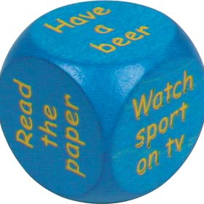
Organisational Decision Making
Organisational decisions can be characterised as being either:
Operational
Tactical
Strategic
http://taosgifts.co.uk/dad-dice---make-your-mind-up-dice---decision-maker-728-p.asp

Slide 13
Business Models

Slide 14
Business Models
Products / Services
Market
Organization
Core Business
Competitors
Resources
Business Environment
Business Climate

Slide 15
OUTPUTS
Organization
Products / Services
{mission,
internal structure, geographic structure, processes, culture, history}
Market
Core Business
{core competencies,
purpose,
strategy}
Resources
{finance, people, technology, skills, raw materials, information, assets}
INPUTS
Business Environment

Slide 16
OUTPUTS
Products / Services
Organization
Market
{product portfolio,
services}
{customers,
consumers,
channels}
Core Business
Competitors
{direct substitutes,
indirect substitutes}
Business Environment

Slide 17
Organization
Market
Core
Business
Business
Climate
Resources
{legislation,
economy,
culture}
Competitors
INPUTS
{industries, suppliers, strategic alliances, parent company, trade unions, professional institutions}
Business Environment

Slide 18
Organisational Architecture

Slide 19
Organisational Architecture
Delineates the space (physical and virtual) where the business activities take place, constraining and facilitating actions
Comprises of formal and informal elements
Changes to one element may trigger changes in other elements
Data integrates the formal elements
Interaction between elements provides the context in which information is interpreted and used.

Slide 20
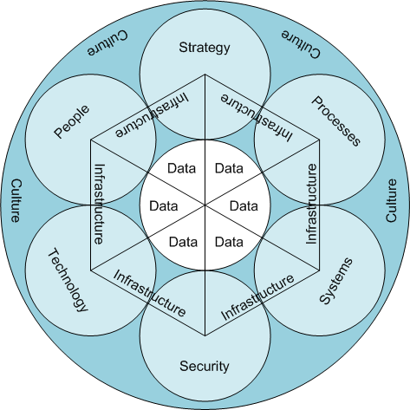
Formal Elements
Figure 1.6

Slide 21
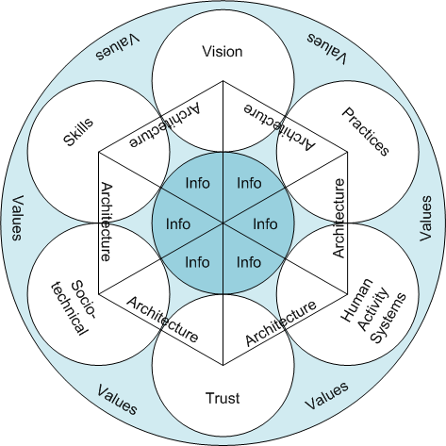
Informal Structures
Figure 1.6

Slide 22
Summary

Slide 23
Topic Learning Outcomes
At the completion of this topic, you will be able to:
Discuss the role of information in organisations, and explain how it can be categorised by source, subject and type
Explain how a generic business model can be used to understand the context of information in an organisation

Slide 24
In the next topic…
At the completion of this topic, you will be able to:
Explain how the value of information in an organisation can be measured.
Explain a generic information lifecycle in terms of a particular set of information

